Slide 1




My Algebra Interactive Notebook
$$3ab$$
$$2x+3y$$
$$\frac{5xy}{6}$$
Name :
Class :
Term 2 Semester 1
$$y=2x+1$$

Slide 2
Contents
Glossary
Page
Date
Description
2
3

Slide 3
Tasks
24
7
30
Essential Question
Questions
Notes
Summary
4
5

Slide 4
Activity- Think/Pair/Share
Write down as many real world situations where people use the concept of fractions in one minute (or maybe half a minute…)
Notes:
Set

Slide 5
Activity- Think/Pair/Share
Write down as many real world situations where people use the concept of fractions in one minute (or maybe half a minute…)
Distance
Time
Building
Cooking
Sport
Shopping
Music
Assessments
Notes:
Set

Slide 6
24
7
30
Date
Types of Fractions & Fractions of Amounts
EQ – How do we convert between different types of fractions and how do we find fractions of an amount?
5
Notes:
Input

Slide 7
24
7
30
Date
Types of Fractions & Fractions of Amounts
EQ – How do we convert between different types of fractions and how do we find fractions of an amount?
What is a fraction?
5
Notes:
Input

Slide 8

24
7
30
Date
Types of Fractions & Fractions of Amounts
EQ – How do we convert between different types of fractions and how do we find fractions of an amount?
What is a fraction?
$$\frac{3}{8}$$
A fraction is part of a whole amount.
A slice of pizza is a fraction of the whole pizza
Numerator
Denominator
5
Notes:
Input

Slide 9
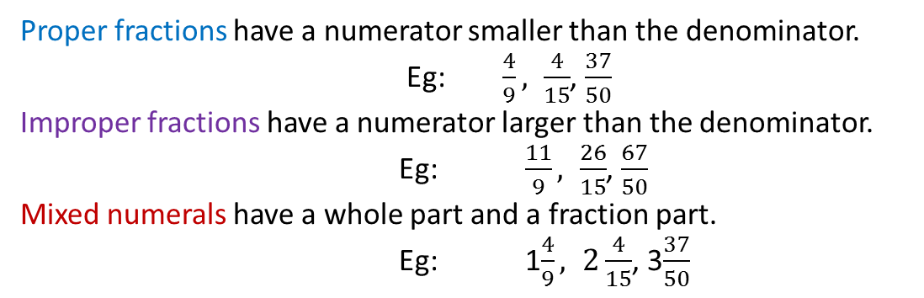
24
7
30
Date
Types of Fractions & Fractions of Amounts
EQ – How do we convert between different types of fractions and how do we find fractions of an amount?
What is a fraction?
$$\frac{3}{8}$$
A fraction is part of a whole amount.
A slice of pizza is a fraction of the whole pizza
Numerator
Denominator
What are the different types of fraction?
Proper fractions have a numerator smaller than the denominator.
Eg: $\frac{4}{9}, \frac{4}{15}$, $\frac{37}{50}$
Improper fractions have a numerator larger than the denominator.
Eg: $\frac{11}{9}, \frac{26}{15}$, $\frac{67}{50}$
Mixed numerals have a whole part and a fraction part.
Eg: 1$\frac{4}{9}, 2\frac{4}{15}$, 3$\frac{37}{50}$
5
Notes:
Input

Slide 10
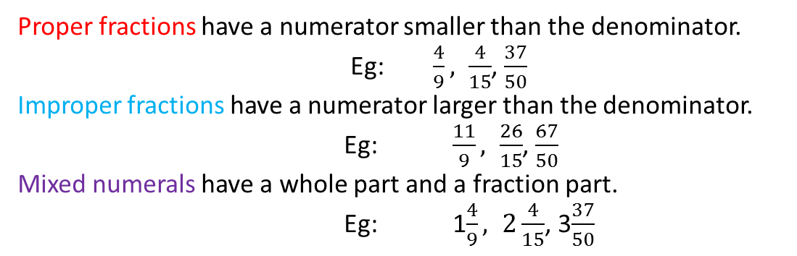
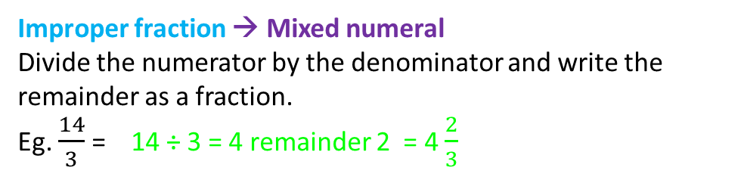
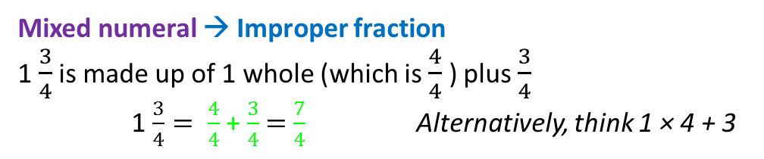
24
7
30
Date
Types of Fractions & Fractions of Amounts
EQ – How do we convert between different types of fractions and how do we find fractions of an amount?
What are the different types of fraction?
Proper fractions have a numerator smaller than the denominator.
Eg: $\frac{4}{9}, \frac{4}{15}$, $\frac{37}{50}$
Improper fractions have a numerator larger than the denominator.
Eg: $\frac{11}{9}, \frac{26}{15}$, $\frac{67}{50}$
Mixed numerals have a whole part and a fraction part.
Eg: 1$\frac{4}{9}, 2\frac{4}{15}$, 3$\frac{37}{50}$
Converting between these types
Mixed numeral → Improper fraction
1 $\frac{3}{4}$ is made up of 1 whole (which is $\frac{4}{4}$ ) plus $\frac{3}{4}$
1 $\frac{3}{4}= \frac{4}{4}$ + $\frac{3}{4}$ $=$ $\frac{7}{4}$ Alternatively, think 1 × 4 + 3
Improper fraction → Mixed numeral
Divide the numerator by the denominator and write the remainder as a fraction.
Eg. $\frac{14}{3}$ = 14 ÷ 3 = 4 remainder 2 = 4 $\frac{2}{3}$
5
Notes:
Modelling

Slide 11
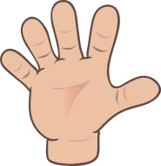
Do you understand? Fists of Five
Notes:
Check for Understanding

Slide 12


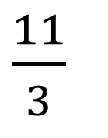
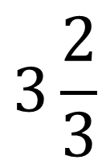
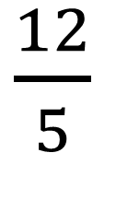
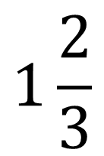

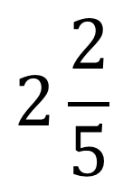
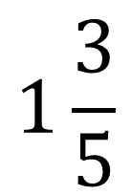
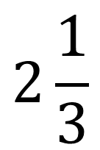
Activity- Match the improper fraction to the mixed numeral
$\frac{5}{3}$
$$1\frac{2}{3}$$
$\frac{12}{5}$
$\frac{11}{3}$
$$1\frac{3}{5}$$
$$2\frac{1}{3}$$
$\frac{7}{3}$
$$2\frac{2}{5}$$
$\frac{8}{5}$
$$3\frac{2}{3}$$
Notes:
Guided Practice

Slide 13
Task
Complete Exercise 6.3 (Pg 76) in the Dwyer Textbook
Notes:
Independent Practice

Slide 14

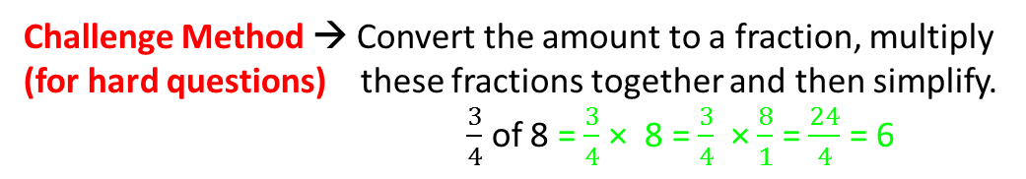
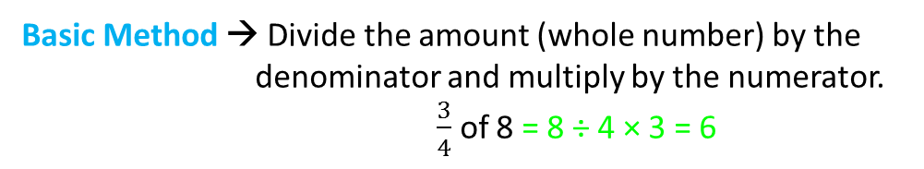

24
7
30
Date
Types of Fractions & Fractions of Amounts
EQ – How do we convert between different types of fractions and how do we find fractions of an amount?
How do we convert between these types?
Mixed numeral → Improper fraction
1 $\frac{3}{4}$ is made up of 1 whole (which is $\frac{4}{4}$ ) plus $\frac{3}{4}$
1 $\frac{3}{4}= \frac{4}{4}$ + $\frac{3}{4}$ $=$ $\frac{7}{4}$ Alternatively, think 1 × 4 + 3
Improper fraction → Mixed numeral
Divide the numerator by the denominator and write the remainder as a fraction.
Eg. $\frac{14}{3}$ = 14 ÷ 3 = 4 remainder 2 = 4 $\frac{2}{3}$
How do we find a fraction of an amount?
Basic Method → Divide the amount (whole number) by the denominator and multiply by the numerator.
$\frac{3}{4}$ of 8 = 8 ÷ 4 × 3 = 6
Challenge Method → Convert the amount to a fraction, multiply (for hard questions) these fractions together and then simplify. $\frac{3}{4}$ of 8 = $\frac{3}{4}$ × 8 = $\frac{3}{4}$ × $\frac{8}{1}$ = $\frac{24}{4}$ = 6
5
Notes:
Extra Input & Modelling

Slide 15
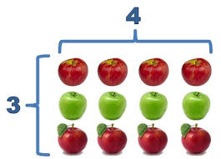
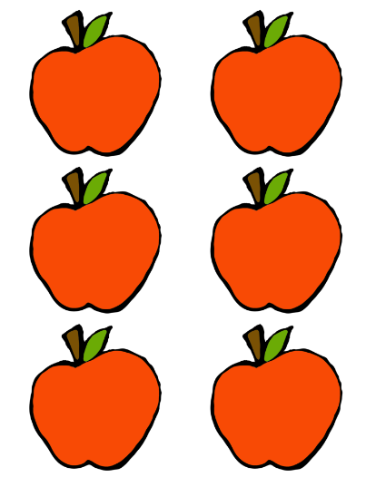

Task
$\frac{2}{3}$of 12
$\frac{3}{4}$of 12
$\frac{4}{8}$of 12
$\frac{4}{9}$of 27
$\frac{5}{8}$of 32
$\frac{1}{4}$of 6
$\frac{3}{8}$of 6
Notes:
Extra Guided Practice

Slide 16
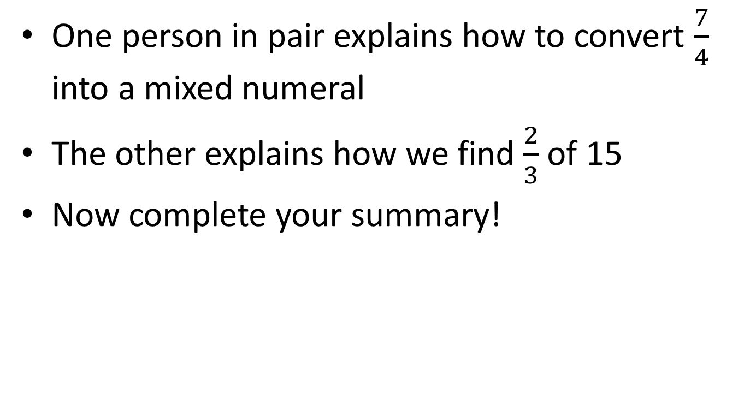
Final Challenge
One person in pair explains how to convert $\frac{7}{4}$ into a mixed numeral
The other explains how we find $\frac{2}{3}$ of 15
Now complete your summary!
Notes:
Closure

Slide 17
Notes Review
24, 7 ,30
Date
Title
Essential question
Notes complete
Notes complete with colour and diagrams
Questions completed
Contents page filled in
Formula page filled in

